Slide 1
Radar and Navigational Aids (18ECE221T) . UNIT – 1. Introduction to Radar Equation . Sessions – 1, 2, 3, … 9.
Prepared by,
Dr. Sandeep Kumar P.

Slide 2
Session - 1
Introduction - Basic Radar & Radar Frequencies - Applications of Radar

Slide 3
What is RADAR?
The word radar is an abbreviation for RAdio Detection And Ranging
Radar is an electromagnetic systems used for detection and location of objects such as aircraft, ship, vehicles, people, natural environment etc.
Radar systems use modulated waveforms and directive antennas to transmit electromagnetic energy into a specific volume in space to search for targets.
Objects (targets) within a search volume will reflect portions of this energy (radar returns or echoes) back to the radar.
These echoes are then processed (Afterwards they are called as video signals) by the radar receiver to extract target information such as range, velocity, angular position, and other target identifying characteristics.

Slide 4
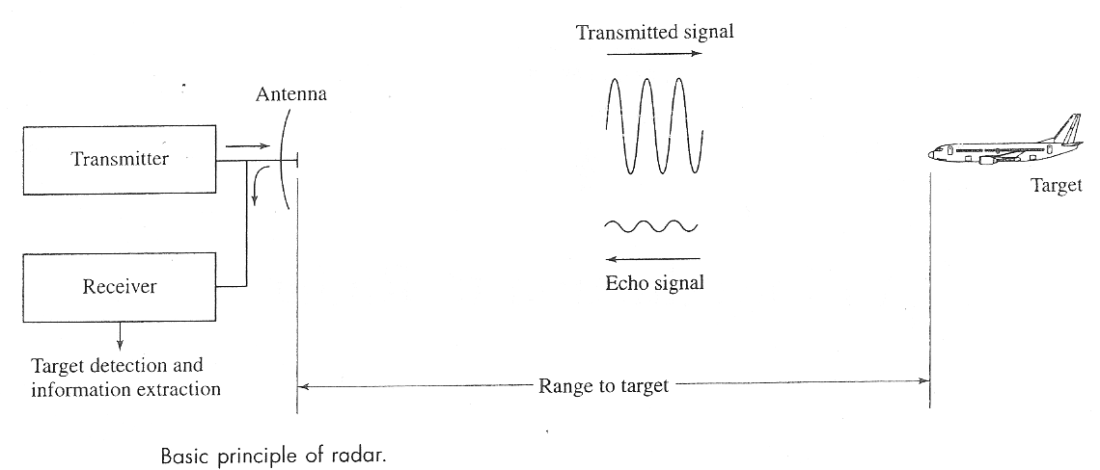
Radar Principles
Transmitter generates and transmits electromagnetic wave (sine or pulse).
A portion of it is reflected back by the target (object you want to identify).
The radiated portion is collected by the radar antenna and processed.
One antenna can be used for both transmission and reception.

Slide 5
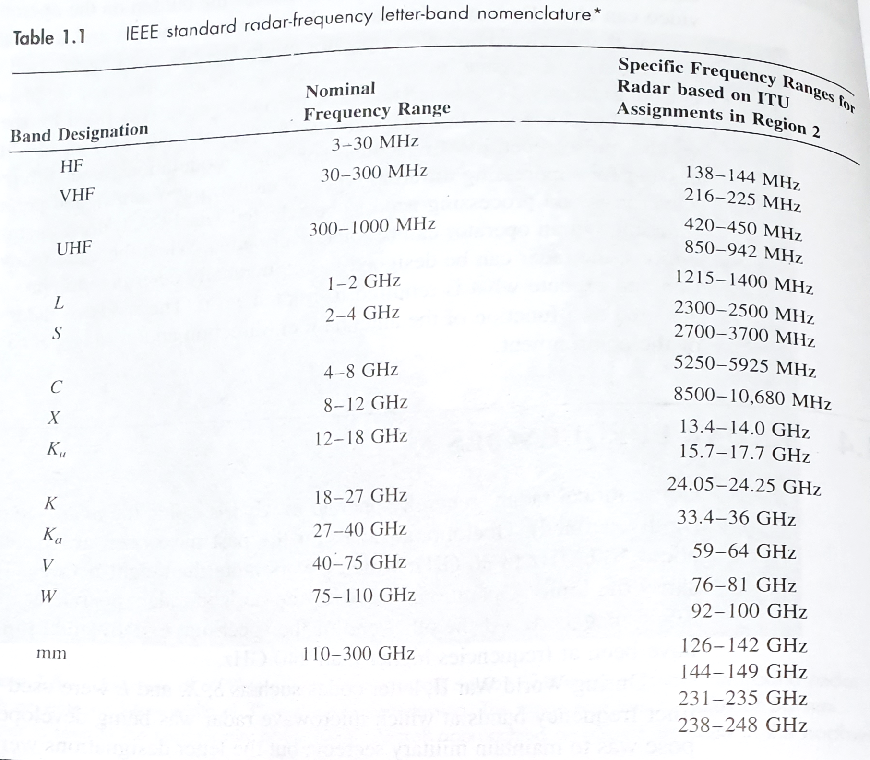
Radar Frequencies

Slide 6
Applications of Radar
Air Traffic control
Aircraft navigation
Ship safety
Remote Sensing
Law enforcement
Military

Slide 7
Session - 2
The Simple form of Radar Equation & Tutorials

Slide 8
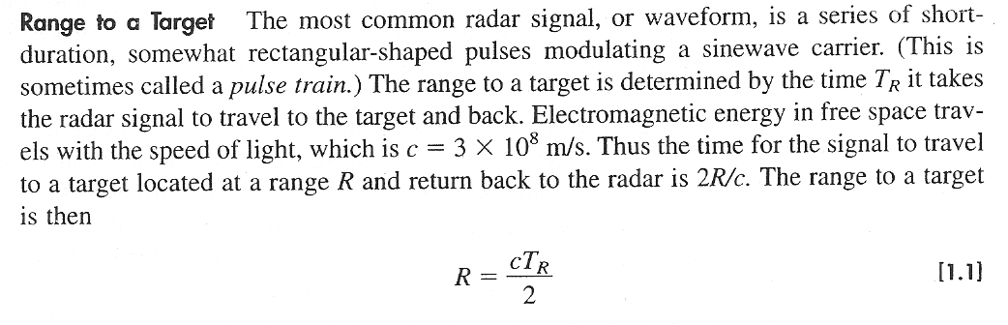
Range- Distance from you and the target!
The range of the object is found by the time the pulse takes to travel to and from the detected object

Slide 9
Radar Equation
The radar equation relates the range of a radar to the characteristics of the transmitter, receiver, antenna, target, and environment.
It is useful for determining the maximum distance from the radar to the target
it can serve both as a tool for understanding radar operation and as a basis for radar design.
However it cannot give the precise value. Why??
Statistical nature of noise and signal
Fluctuation & uncertainty of the target
Propagation effect of the wave
Losses
Are affecting the calculation
We will consider each one separately.

Slide 11
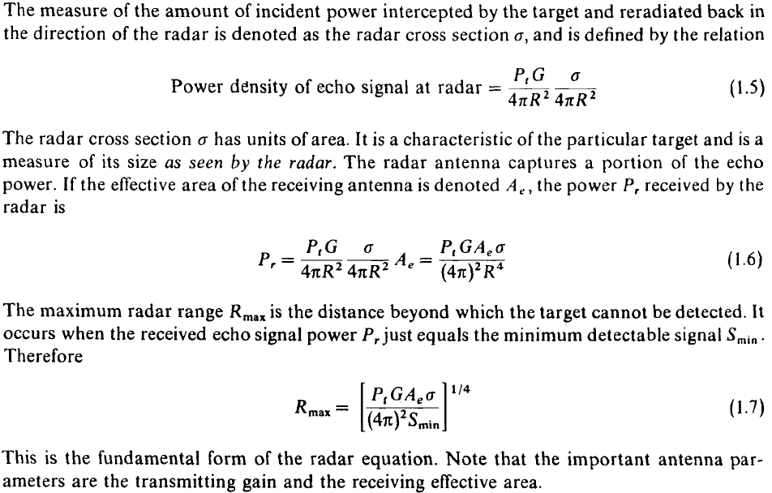

Slide 12
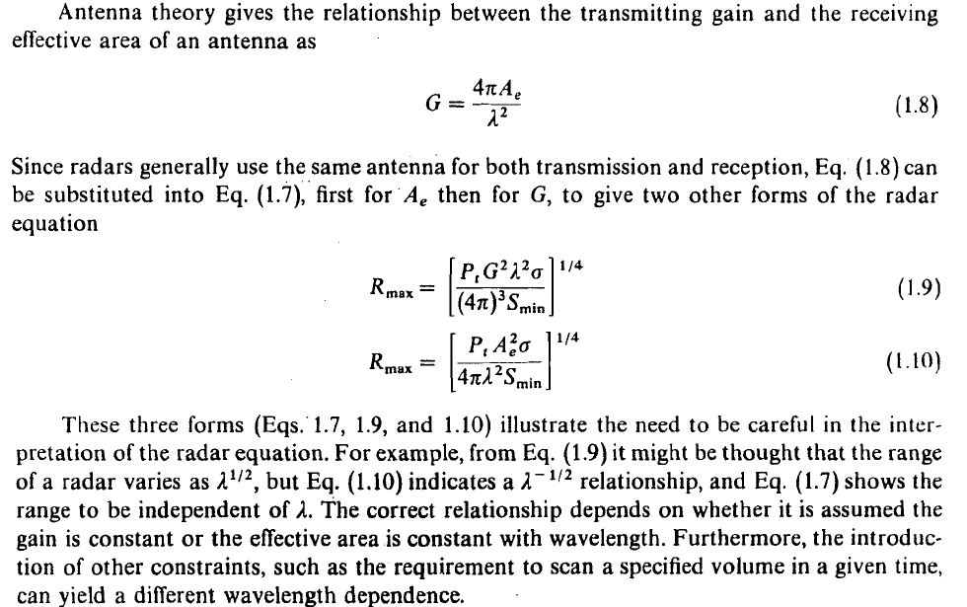

Slide 13
The Radar Equation- Considerations of various parameters
As I pointed out earlier there are many factors which we have to consider in the range equation. They affect the calculation.
But we can model them and mathematically find the model and insert in the range equation.
Noise is in the system and it is random. So we have to have probability.
If affects the detection. So we have to get SNR
Pulse repetition frequency
Cross section of the target exposed to the wave we send

Slide 14
To increase the range
Transmitted power is increased
Gain of the antenna should be high
Large antenna for reception
The receiver should be sensitive to weak signals (should pick them)
Range equation is an important derivation we are going to do to calculate the range.

Slide 15
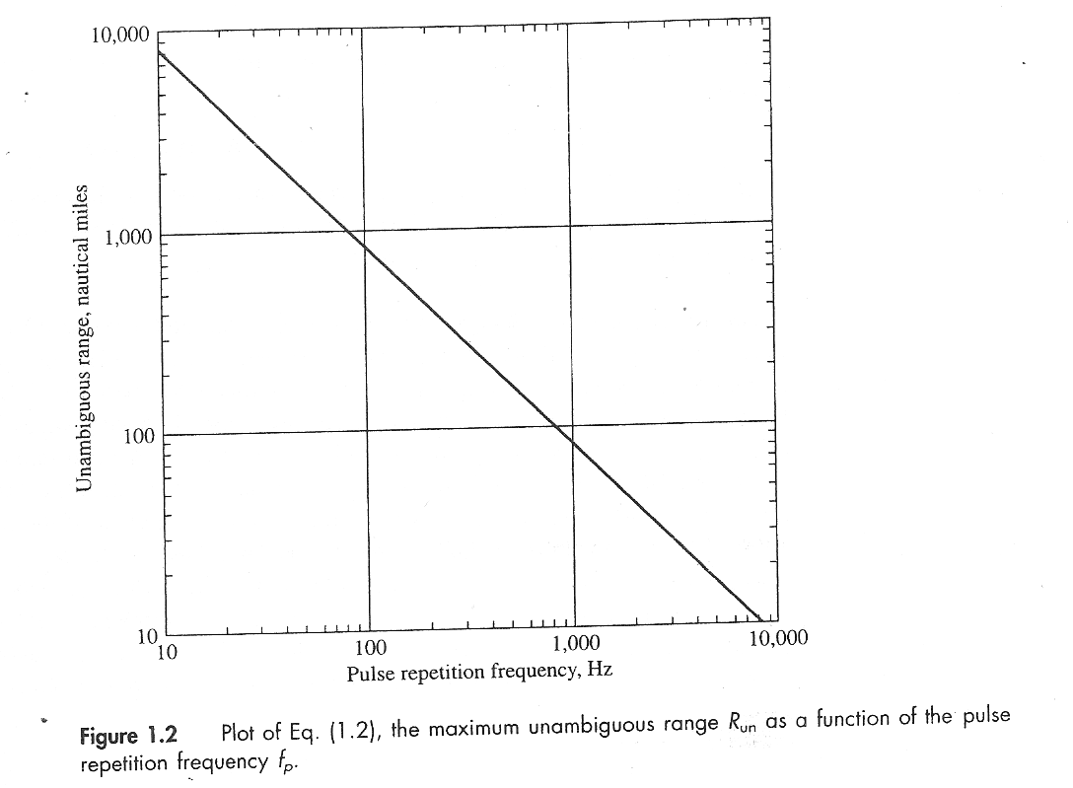
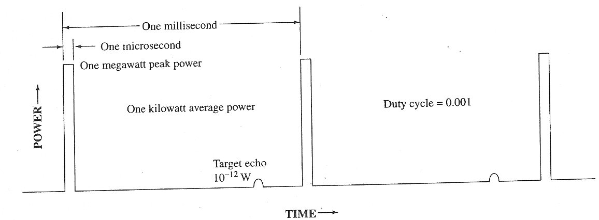
Maximum unambiguous range
We send a train of pulses. Not a single pulse. A pulse is sent and reflected back as echo.
We have to wait to get for the echo before we send the next one
If not the echo for the first pulse we sent will become echo for the second one. This is called second time around pulse
Due to this the target may look near (as you get the echo immediately for the send pulse: this echo was for the first pulse!!!!)
So the pulse repetition frequency (PRF) is important and it determines the maximum unambiguous range
R_{un} = cTp/2 = c/ 2fp

Slide 16
Session - 3
Radar Block Diagram & Receiver Noise

Slide 17
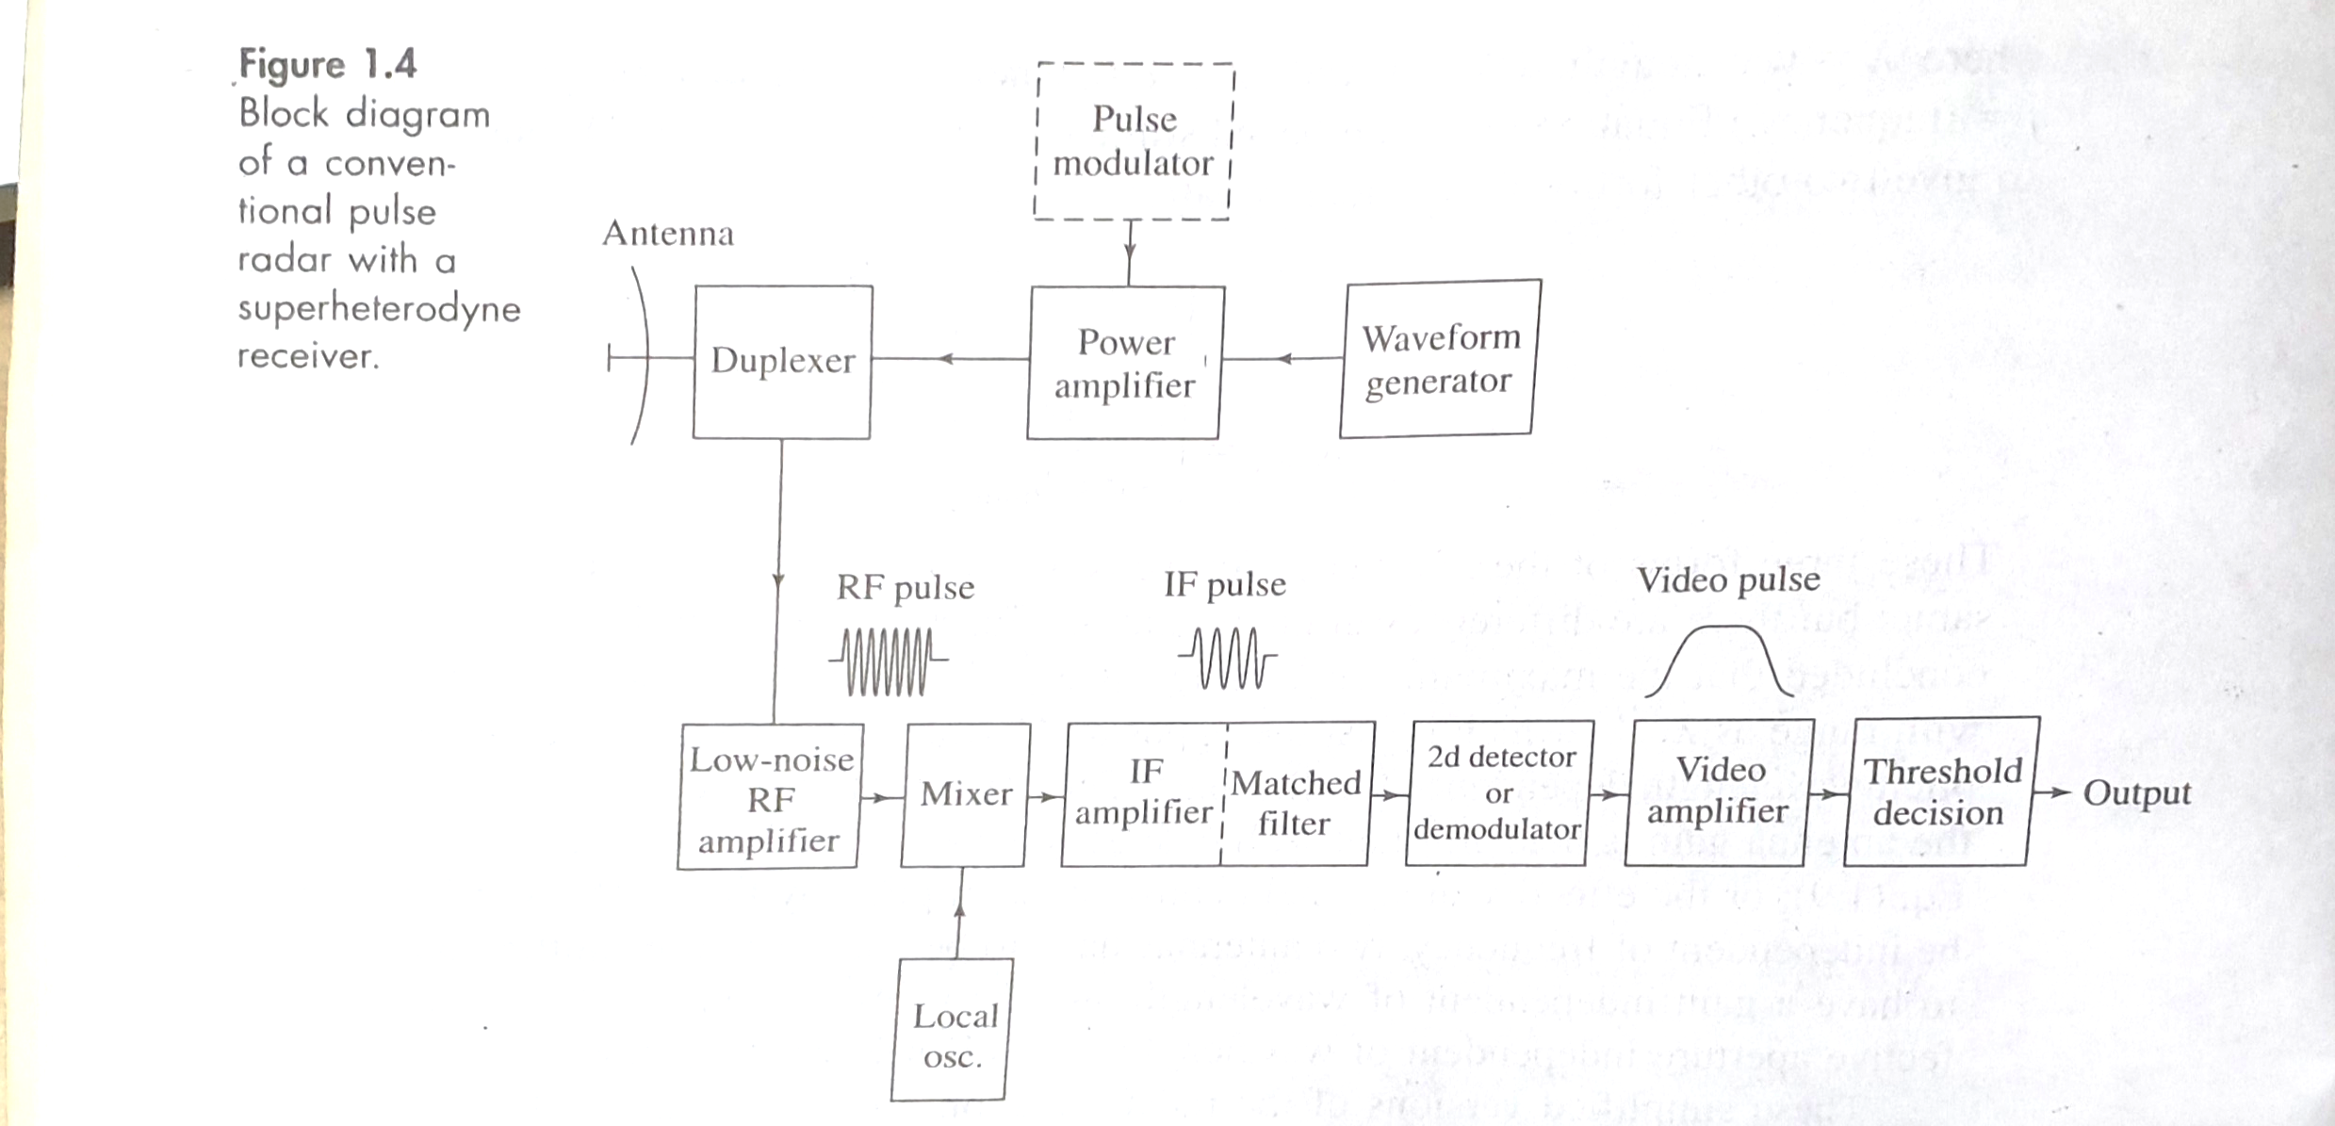
RADAR Block Diagram

Slide 18
RADAR Operation
Transmitter – Power Amplifier – Reflex klystron/ TWT, Power oscillator - magnetron, Pulse modulator - " pulsed"-(turned on and on) by the modulator to generate a repetitive train of pulses in synchronism with the low power input pulses.
Example: to detect aircraft at ranges of 100 or 200 nmi you need
peak power of the order of a megawatt,
a pulse width of several microseconds,
pulse repetition frequency of several hundred pulses per second.
The waveform generated by the transmitter travels via a transmission line to the antenna, where it is radiated into space.
A single antenna is generally used for both transmitting and receiving.

Slide 19
Duplexer
The duplexer protects the receiver from high transmission power.
consist of two gas-discharge devices, one known as a TR (transmit-receive) and the other an ATR
(anti-transmit-receive).
The TR protects the receiver during transmission and the ATR directs the echo signal to the receiver during reception.
Solid-state ferrite circulators and receiver protectors with gas-plasma TR devices and/or diode limiters are also employed as duplexers.

Slide 20
Receiver
The receiver is usually of the superheterodyne type.
The first stage low-noise RF amplifier, such as a parametric amplifier or a low-noise transistor.
The mixer and local oscillator (LO) convert the RF signal to IF.
A typical Intermediate Frequency (IF) amplifier for an air-surveillance radar might have a center frequency of 30 or 60 MHz and a bandwidth of the order of one megahertz.
The IF amplifier should be designed as a matched filter - frequency-response function - maximize the
signal-to-mean-noise-power ratio
This occurs when the
magnitude of the frequency-response function = the magnitude of the echo signal spectrum
the phase spectrum of the matched filter = negative of the phase spectrum of the echo signal
In a radar whose signal waveform approximates a rectangular pulse, the conventional IF filter bandpass characteristic approximates a matched filter when the product of the IF bandwidth B and the pulse width r is of the order of unity, that is, Br=- 1.

Slide 21
2nd Detector & Display
Demodulates the pulse modulation
Amplified by the video amplifier
Displayed on a CRT- This is a special CRT called PPI-plan position indicator

Slide 22
Display
The most common form of cathode-ray tube display is the plan position indicator, or PPI which maps in polar coordinates the location of the target in azimuth and range.
This is an intensity-modulated display in which the amplitude of the receiver output modulates the electron-beam intensity (z axis) as the electron beam is made to sweep outward from the center of the tube.
The beam rotates in angle in response to the antenna position.
B-scope display is similar to the PPI except that it utilizes rectangular, rather than polar, coordinates to display range vs. angle.
Both the B-scope and the PPI, being intensity modulated, have limited dynamic range.
A Scope- which plots target .amplitude axis) vs. range axis), for some fixed direction. This is a deflection-modulated display. It is more suited for tracking-radar application than for surveillance radar.

Slide 23
Session - 4
Signal-to-Noise Ratio & Integration of Radar Pulses

Slide 24
Detection of Signals in Noise
MINIMUM DETECTABLE SIGNAL
Noise affects the systems
The weakest signal which can be detected by radar is called as minimum detectable signal and it is included in the radar equation.
> target is present
-----→ received signal-----→ Threshold--→
< target is absent
This is called threshold detection

Slide 25
Threshold detection: two problems
false alarm: if the threshold is set as low then the noise may be detected as target
Missed detection: If the threshold is set high then real target will be missed.
However we use matched filter which will increase the SNR.
So we conclude that SNR is an important factor and more analysis is needed.

Slide 26
Session - 5
Radar Cross Section of Targets-Simple Targets & Radar Cross Section of Targets- Complex
Targets Transmitter Power

Slide 27
Radar Cross Section of Targets
σ is the radar cross section.
It is the area covered and it will be proportional to the magnitude wave reflected. So we can define this parameter in dB
Since the wave is covering a volume/ area we can define this parameter as
This power reflected can be found by solving Maxwell’s equation.
Radar wavelength and dimension of the target are two important parameters which define this
If the wavelength is larger than the dimension of the target Raleigh scattering occurs. Example rain
if the Wavelength is smaller than the target the scattering lies in the optical region. Example aircraft
If the wavelength and the object is of same dimension then it is in the resonance region

Slide 28
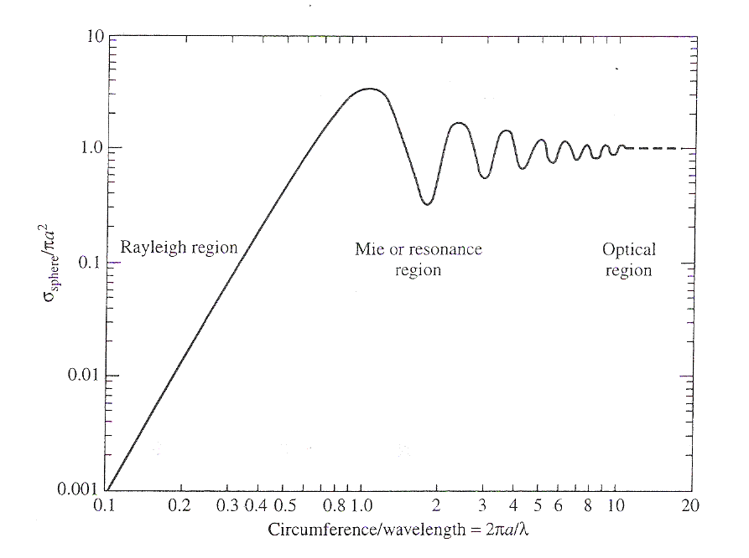
Sphere
Here the σ is directly proportional to f⁴ in resonance region
σ nearly equal in resonance region
σ very small. No scattering only a small bright spot is seen.(if you take a photograph of a polished metal ball, you will see only a small bright spot: not the ball)
=1
At resonance it oscillates.
Attains maximum at =1

Slide 29
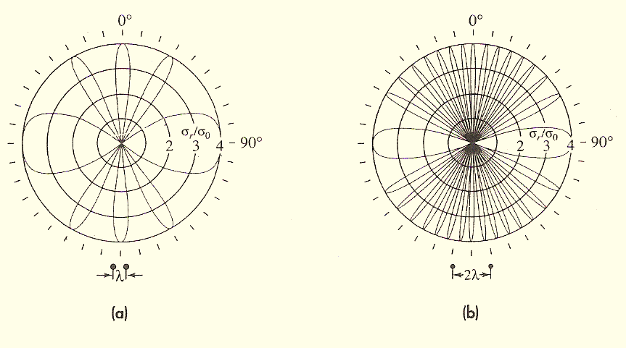
Complex targets
Aircrafts, buildings, missiles are some examples
It depends on the viewing angle and frequency (wavelength)
One complex target will have two or more surfaces which scatters the incoming waveform
They can be each modeled as cone, sphere, flat or rod shaped.
So we can calculate them individually and add them together.
That is the reason we studied the above separately
We should also note that the phase of each signal reflected will be different and depend on the angle
Here we see two scatters showing the change in the magnitude with respect to change in the viewing angle

Slide 30
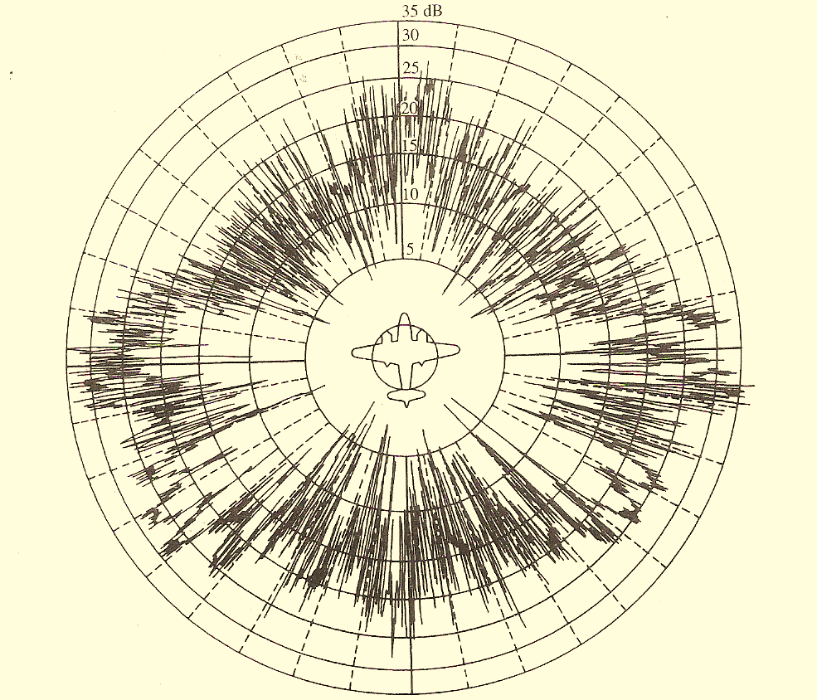
An Aircraft
The scattering shown as polar plot.
We see more signals are reflected back when viewed along
Sideways: Flat surface
Nose and tail. Cone and sphere
Engine will modulate the echo signal.
The fluctuations in the reflected signal are low when you use microwave frequency and high when you use low frequency.

Slide 31
Session - 6
Radar cross Section Fluctuations & Swirling Target Model

Slide 32
Radar cross Section Fluctuations
The fluctuations are due to the following reasons
Change in viewing angle
Individual scatters
Echo from each scatter will have different amplitude and phase
Multiple reflections
Shadowing one scatter by another
Phase shift of more than 2*pi causes amplitude changes
Take more scans and see the results. This is one of the solutions.

Slide 33
Four Swirling model
To study the fluctuations in detail Four Swirling model is used
Case 1:
Each scan give constant amplitude but different correlation
This is called slow fluctuations (Scan to Scan fluctuations)
Raleigh scatters belong to this category
Case 2
Each pulse give different output
Each of them independent
Case 3:
Same as case 1 but different pdf
Case 4:
Fluctuations is pulse to pulse and same pdf as case 3
The fluctuation affect the probability of detection
Fluctuations are usually small.
We see the four cases using a diagram and we see that case 1 will create more problems

Slide 34
Inference from all the models
The probability-density function assumed in cases 1 and 2 applies to a complex target consisting of arbitrary independent scatterers of approximately equal echoing areas.
Although, in theory, the number of independent scatterers must be essentially infinite, in practice the number may be as few as four or five.
The probability-density function assumed in cases 3 and 4 is more indicative of targets that can be represented as one large reflector together with other small reflectors.
In all the above cases, the value of cross section to be substituted in the radar equation is the average cross section σ
The signal-to-noise ratio needed to achieve a specified probability of detection without exceeding a specified false-alarm probability can be calculated for each model of target behavior.
For purposes of comparison, the no fluctuating cross section will he called case 5.

Slide 35
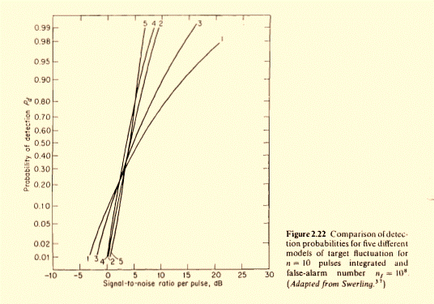
A comparison

Slide 36
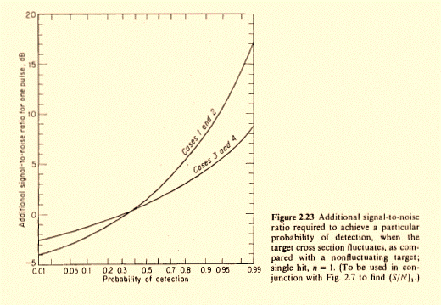
Additional SNR required for a particular performance

Slide 37
Session - 7
Transmitter Power &
Pulse Repetition Frequency

Slide 38
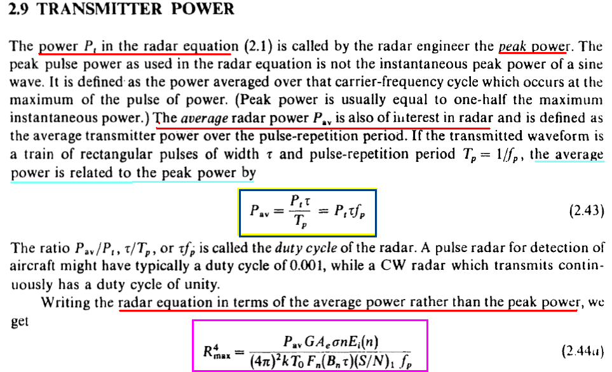

Slide 39
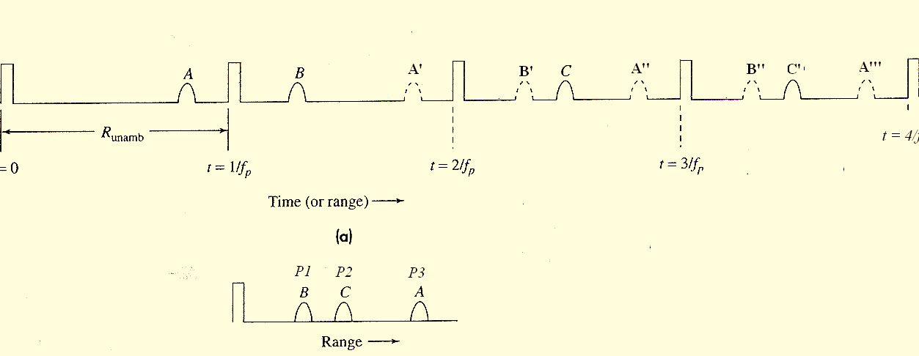
Pulse Repetition Frequency and Range Ambiguities
Suppose you are trying to detect the object A.
It is in unambiguous range. So we get the echo after the pulse repetition.
If suppose there are other two objects B and C which we are not interested, at distance above the unambiguous and twice.
The echoes from these objects will also be seen on the A scope.
Since we are integrating the pulses, we see pulses in position P1, P2, P3 respectively.

Slide 40
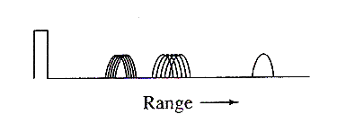
Solution
One method of distinguishing multiple-time-around echoes from unambiguous echoes is to operate with a varying pulse repetition frequency.
The echo signal from an unambiguous range target will appear at the same place on the A-scope on each sweep no matter whether the prf is modulated or not.
However, echoes from multiple-time-around targets will be spread over a finite range

Slide 41
Session - 8
Antenna Parameters &
System losses-Microwave plumbing loss, Antenna loss, Signal Processing loss

Slide 42
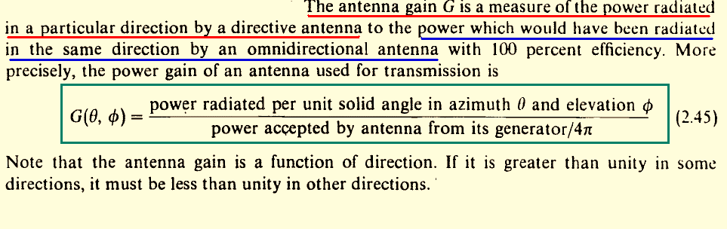

Slide 43
System Losses
losses that occur throughout the radar system.
The losses reduce the signal-to-noise ratio at the receiver output.
They may be of two kinds, Depending upon whether or not they can be predicted
The antenna beam-shape loss, collapsing loss, and losses in the microwave plumbing are examples of losses which can be calculated.
Losses not readily subject to calculation and which
are less predictable include 'those due to field degradation and to operator fatigue or lack of operator motivation.

Slide 44
Plumbing loss
i. Transmission line losses
For low frequency the losses is low
For high frequency the losses is high
So keep the distance between antenna and receiver short as possible
The loss is taken twice as the signal is transmitted and received
ii. Duplexer loss
It is a gas filled section used to protect the receiver form the transmitter.
The transmitter uses very high power and receiver we get only a small from from the reflected
So we use a waveguide shutter which produces loss it can be upto 2dB

Slide 45
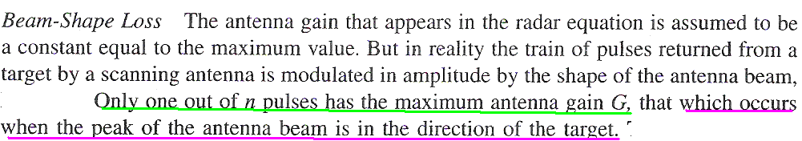
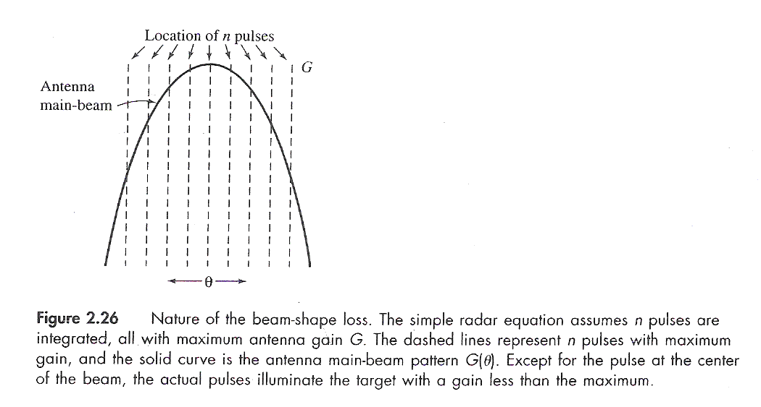
Antenna losses
Scanning losses, Radome losses, Phased array losses

Slide 46
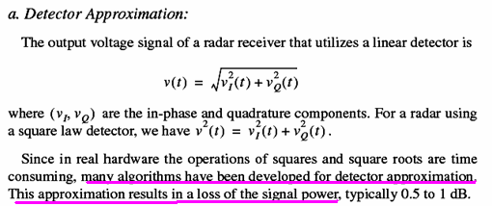
Signal processing loss (1)

Slide 47
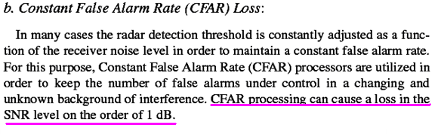
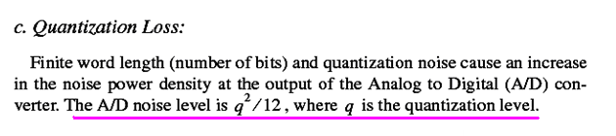
Signal processing loss (2)

Slide 48
Signal processing loss (3)
Non matched filter (0.5-1.0 dB loss) even with Pulse compression filter (matched filter)
Automatic Integrators-binary moving window detector – 1.5-2 dB loss
Threshold level- to prevent excessive false alarm- fractional loss
Limiting loss – pulse compression process- hard limiter to reduce impulsive noise fluctuations – produces greater losses. Hard limiters not used since it reduce clutter attenuation. Band pass hard limiter has 1dB loss
Stradding loss – Losses occurs when signal spectral line is not centered on the filter.It occur in both analog and digital processing.
Sampling loss- The difference between the sampled value and the maximum pulse amplitude represents a sampling loss.
-Sampling rate – once per pulse width – 2dB loss
- three samples per pulse width – 0.2 dB loss
-Reduction in sampling interval reduces the losses.

Slide 49
Session - 9
System losses-Doppler processing,
Collapsing, Operator loss, propagation Effects
&
Other Radar Equation Considerations

Slide 50
Losses in Doppler-processing Radar
Multiple redundant waveforms used to resolve range ambiguities which introduces losses up to 4.3 dB. (Blind speed where target cannot be detected since both pulse repetition time of both transmitted and received signals are same or multiple of the transmitted PRT .
Eclipsing loss- Echoes from multiple time around target arrive back at the radar at the same time of pulse transmitted.
Also produces losses due to the shape of the Doppler filters
Fill pulses with high PRF radar avoid the effects of multiple time around clutter exhoes.

Slide 51
Collapsing Losses
Losses due to integrate additional noise samples along with signal plus noise pulses which degrades the signals.
Losses also occurs when output of high resolution radar shown on a display whose resolution is coarser than inherent radar.
Operator Losses:
Operators used for detection decision
Should be changed for every 30 min to avoid degradation

Slide 52
Other losses
Equipment degradation
Field degradation.
Operator loss

Slide 53
Propagation effect
The radar environment includes terrain and sea surfaces, the atmosphere (including precipitation), and the ionosphere. These may degrade radar observations and performance by producing clutter and other spurious returns, signal attenuation, and bending of the radar-signal path.
Terrain and sea surfaces, which may produce target masking, radar clutter, and multipath interference;
Precipitation, principally rain, which may produce signal attenuation and clutter returns;
The troposphere, which may produce refraction that bends the radar signal path, signal attenuation, and a lens loss;
The ionosphere, which may produce refraction that bends the radar signal path, signal fluctuation and attenuation, waveform dispersion, and rotation of signal polarization.

Slide 54
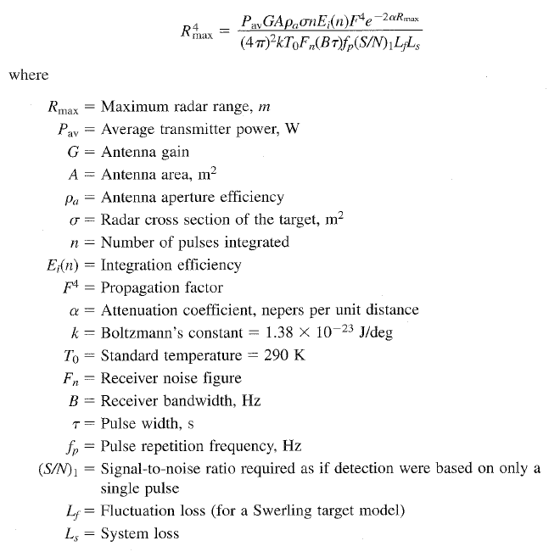
Other Radar Equation Considerations
Prediction of radar
range

Slide 55
Omitting Propagation factors, atmospheric attenuation and fluctuation loss radar range equation can be modified as

Slide 56
Surveillance radar range equation
The scan time/revisit time to be considered

Slide 57
Other considerations
M our of N criterian
Track establishment as a detection criterion
Cumulative probability of detection
Verification at predicted range(blip scan ratio)

Slide 58
1. The ambiguous range of radar is 200km. It has a BW of 1 MHz. Find
Pulse Repetition Frequency
Pulse Repetition Interval
Range Resolution
Pulse width

Slide 59
2. PW=2 us, PRF=800 Hz.
Find (a) Maximum un ambiguous range (b) Range Resolution

Slide 60
3. If a radar has a maximum range of 500km, then find the required PRF to obtain unambiguous reception.

Slide 61
4. A radar operates at 10 GHz and peak power of 500kW. Its minimum receivable power is 0.1pW. The antenna has a capture area of 5.00 sqm and the radar cross section of the target is 20sqm. Find maximum range of radar.

Slide 62
Text Book
Merrill I. Skolnik, “Introduction to Radar Systems”, 3rd Edition, Tata Mc Graw-Hill 2008.

Slide 63
Thank You

